Slide 1



Pick one model from Hugging Face
Sentence | Expect | Expect (Num)
“I love you” | Positive | 1
“I am having breakfast” | Neutral | 0
“I hate you” | Negative | -1
https://huggingface.co/
1 | distilbert-base-uncased-finetuned-sst-2-english
2 | ProsusAI/finbert
3 | yiyanghkust/finbert-tone
4 | finiteautomata/bertweet-base-sentiment-analysis
5 | albert-base-v2
script: HaggingFace_Models.ipynb
Bocheng Yin

Slide 2
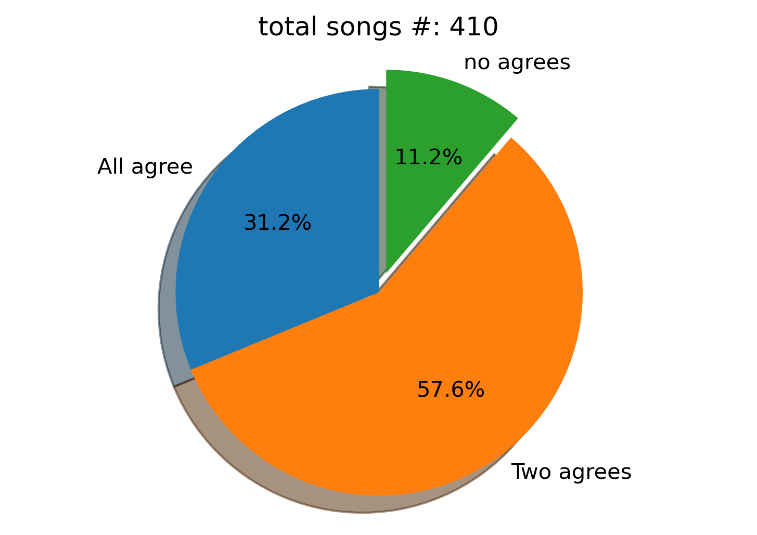
Comparison among pre-trained models
Vader
TextBlob
HF:Bertweet
Script: sentiment_analysis_eval_multi_models_comparison_final.py
Bocheng Yin
Notes:
bertweet-base-sentiment-analysis from HuggingFace

Slide 3
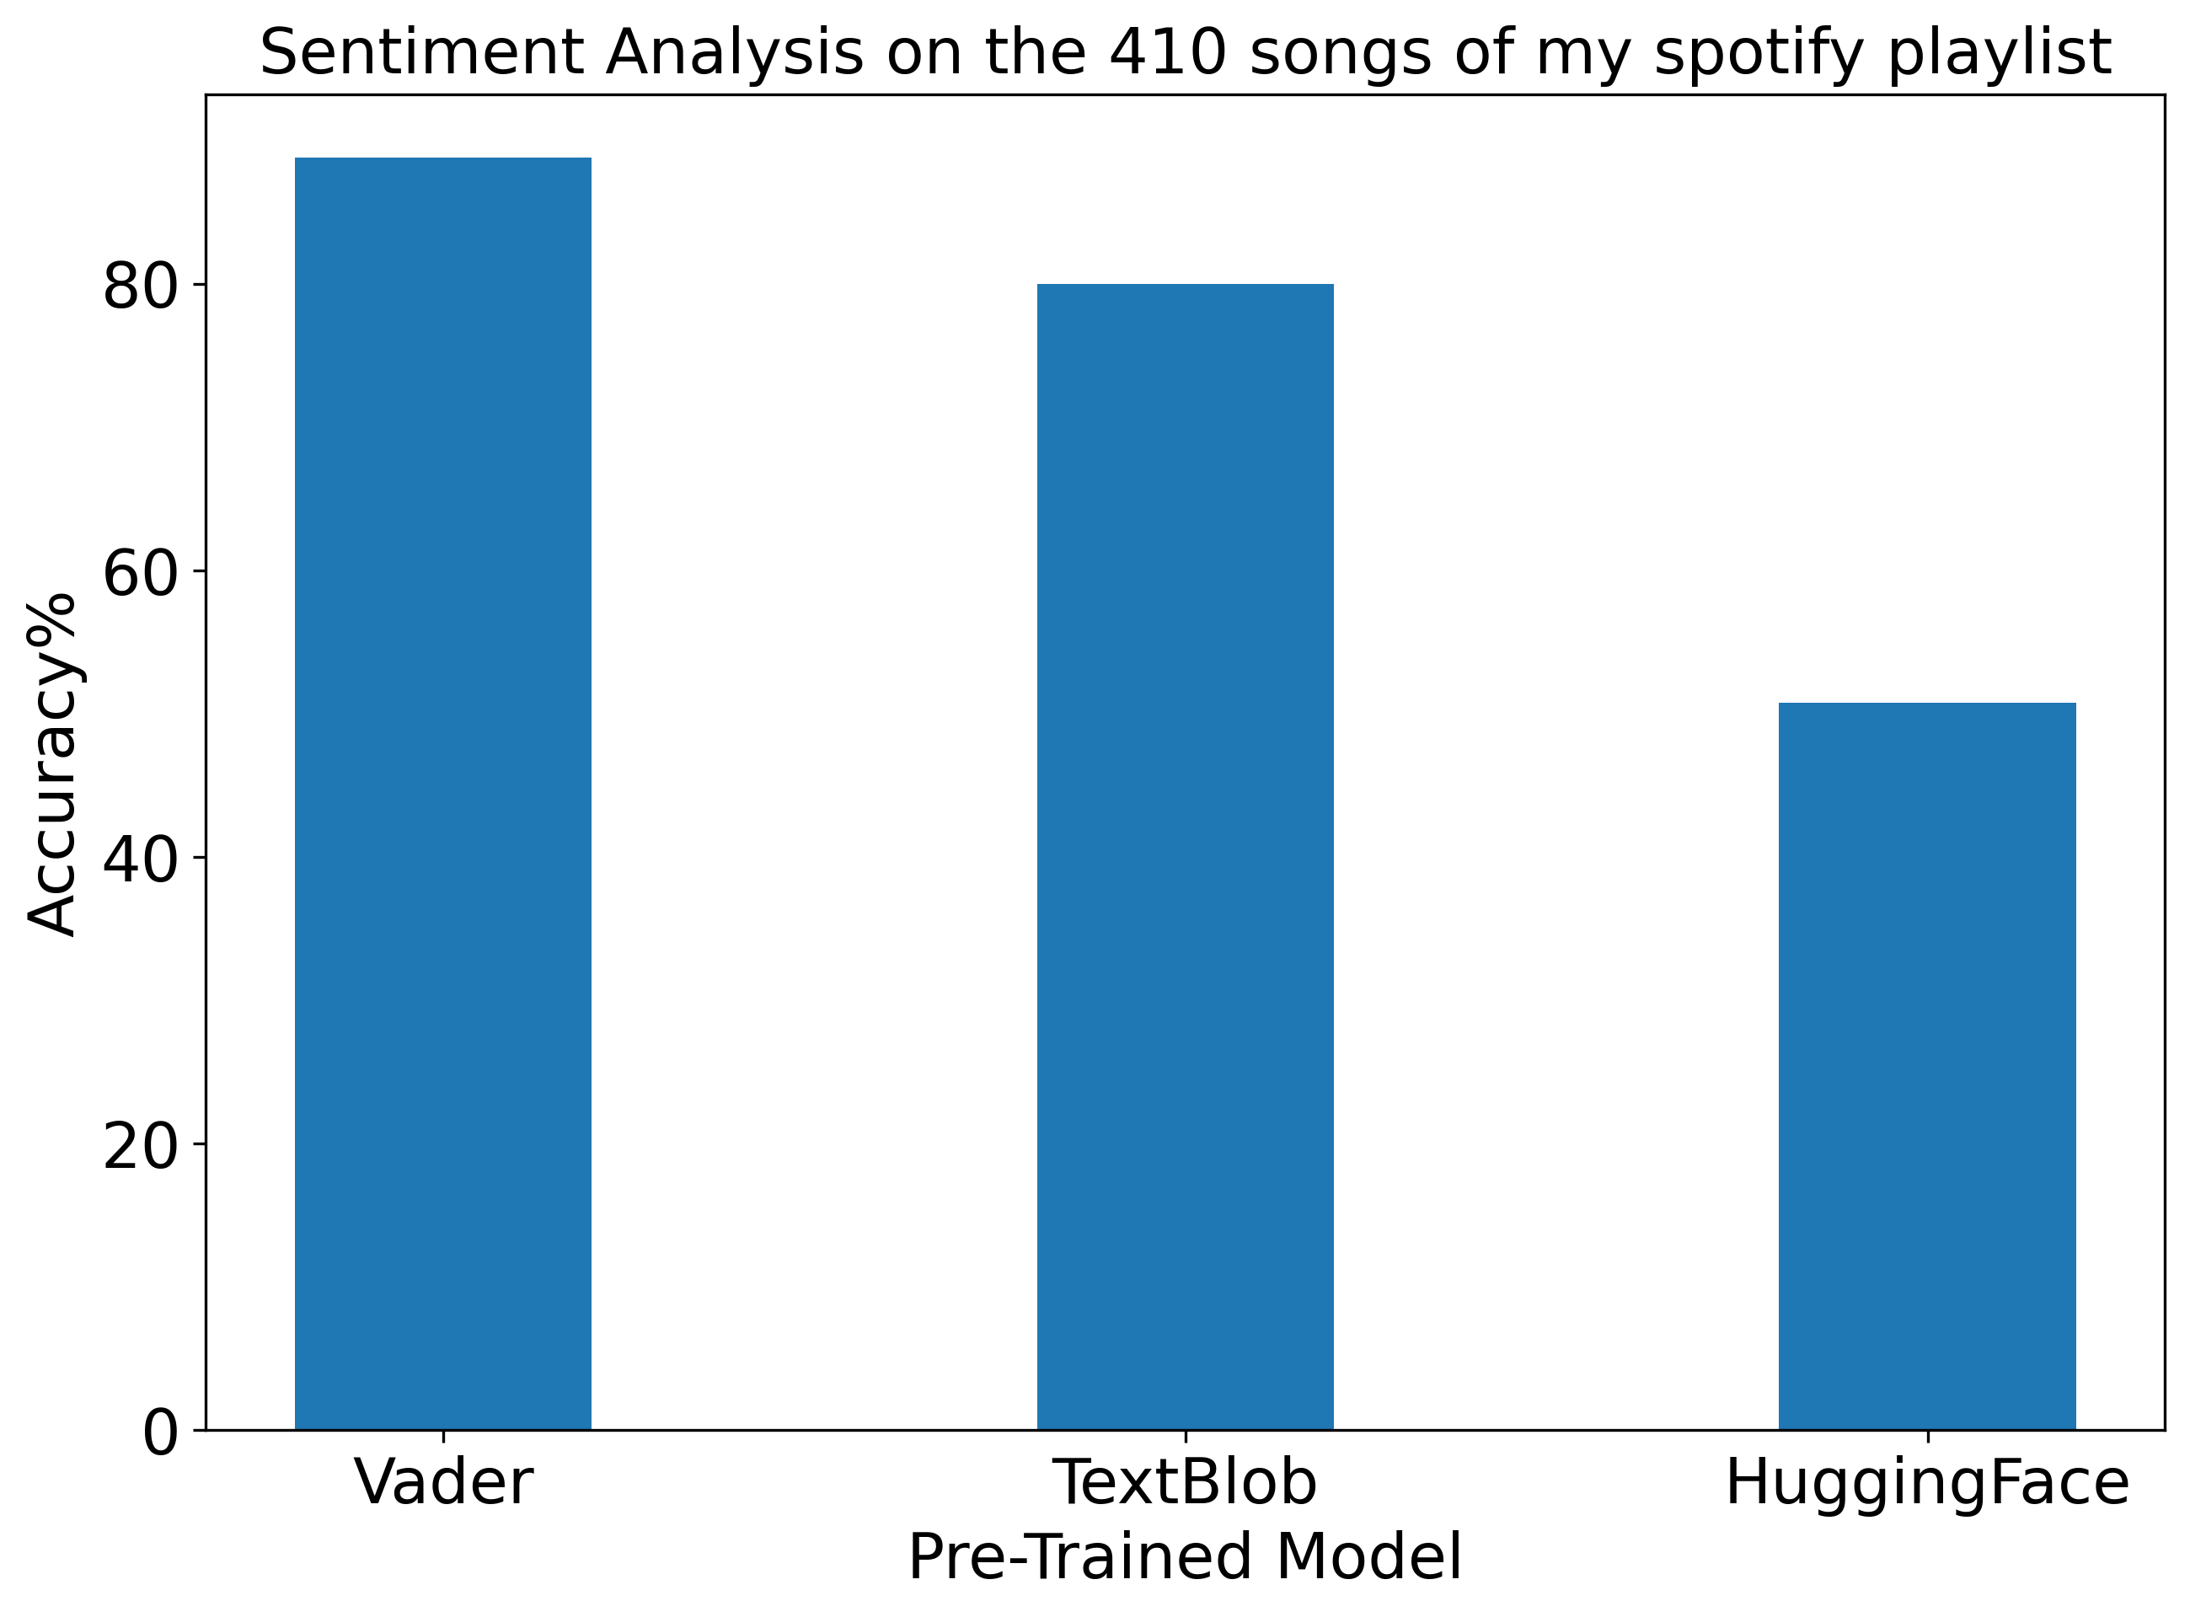
Model Accuracy
Manual evaluation
Compare the model prediction with the manual evaluation
Bertweet
Script: sentiment_analysis_eval_multi_models_comparison_final.py
Bocheng Yin

Slide 4
Summary
Part 1: Retrieve the playlist from Spotify. Fetch the lyrics from musixmatch.
Part 2: Using “Vader” to predict the sentiment on the lyric and do song recommendation based on sentiment score
Part 3: Compare three different sentiment-analysis models and rate the model accuracy referencing to the manual evaluation.

Slide 5
Reference
Spotify console
https://developer.spotify.com/console/
Musixmatch documentation
https://developer.musixmatch.com/documentation
Postman Tutorial - Getting started with Spotify API
https://www.youtube.com/watch?v=N34BM2CU_3g
Spotify Sentiment Analysis
https://towardsdatascience.com/spotify-sentiment-analysis-8d48b0a492f2
The-Most-Favorable-Pre-trained-Sentiment-Classifiers-in-Python
https://github.com/PetrKorab/The-Most-Favorable-Pre-trained-Sentiment-Classifiers-in-Python/blob/main/analysis.ipynb
Sentiment Analysis With Transformer Models Made Easy
https://www.youtube.com/watch?v=Ew72EAgM7FM
Hugging Face, AI community
https://huggingface.co/
Bocheng Yin

Slide 6
Acknowledgement
Prof. Zhai, Chengxiang
All TAs: Assma Boughoula , Kevin Ros, Campos Daniel,
Yuxiang Liu,Harita Reddy, Priyanka Dey
Great Team Members: Zhuoya Chen, Franco Hui, Bocheng Yin
Bocheng Yin

